Slide 1
Capstone Project
Hotel Booking Analysis
Raavi sahu

Slide 2
Content
Importing libraries and Database
Summary of Data
Data wrangling
Data Analysis
Data visualization
Challenges
Conclusion

Slide 3
Importing Libraries and Database
Imported these libraries in order to work on Database.
NumPy
Pandas
Matplotlib
Seaborn

Slide 4
Summary of Data
About Data - This Database consists of information between 2 different hotels over 3 years (2015 to 2017).
Size of Data:
Rows - 119390
Columns – 32

Slide 5
Data wrangling
Data cleaning -
This Database consists of null values ‘Nan’.
Replaced those null values with zero.
Data preparation -
Database consist of different types of data types.
Data types : integer, float, object
Converted the ‘Float’ Data type into ‘integer’ Data type

Slide 6
Data Analysis
Year wise Comparison of Hotel Bookings
Month wise comparison of bookings
Total bookings cancelled
Booking percentage between 2 hotels
Repeated guests percentage between 2 hotels
Booking types for Market segment
Number of night stays in Hotels
Total number of special requests

Slide 7
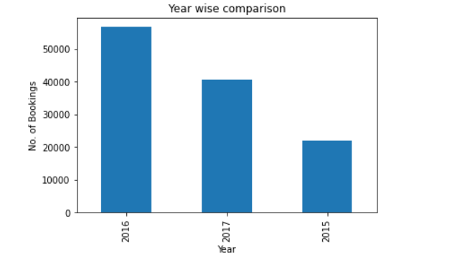
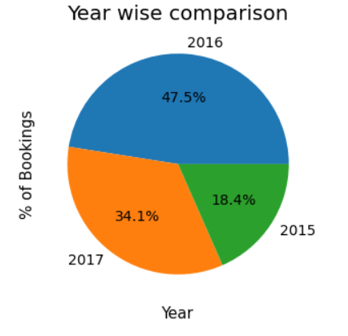
Data Visualization 1. Year wise Comparison of Hotel Bookings
2016 is the most productive year with 47.5%.

Slide 8
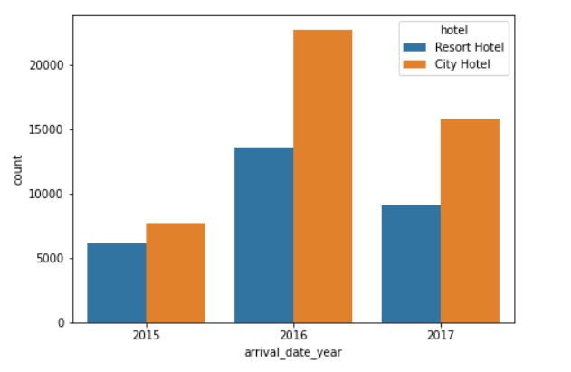
Year wise Booking between two types of Hotels
City Hotels has more number of Bookings.

Slide 9
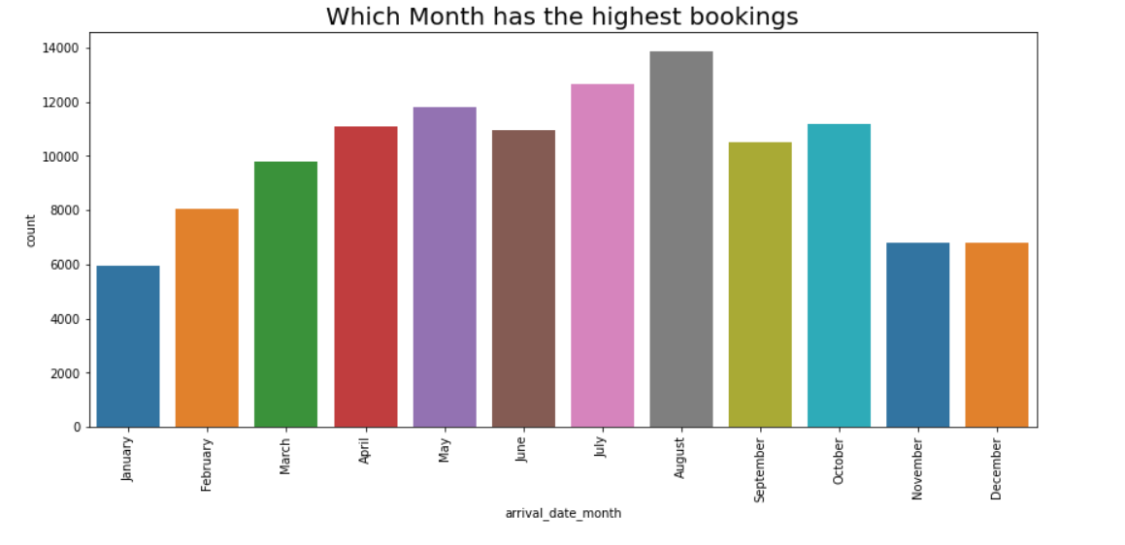
2. Month Wise Comparison of bookings August has highest number of Bookings

Slide 10
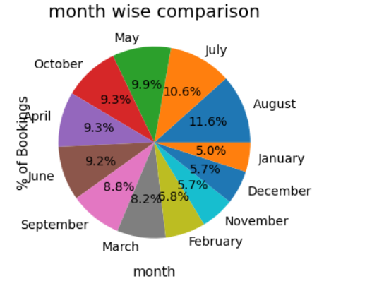
Month wise comparison of Bookings in percentage
August has 11.6% number of Bookings, which is highest.

Slide 11
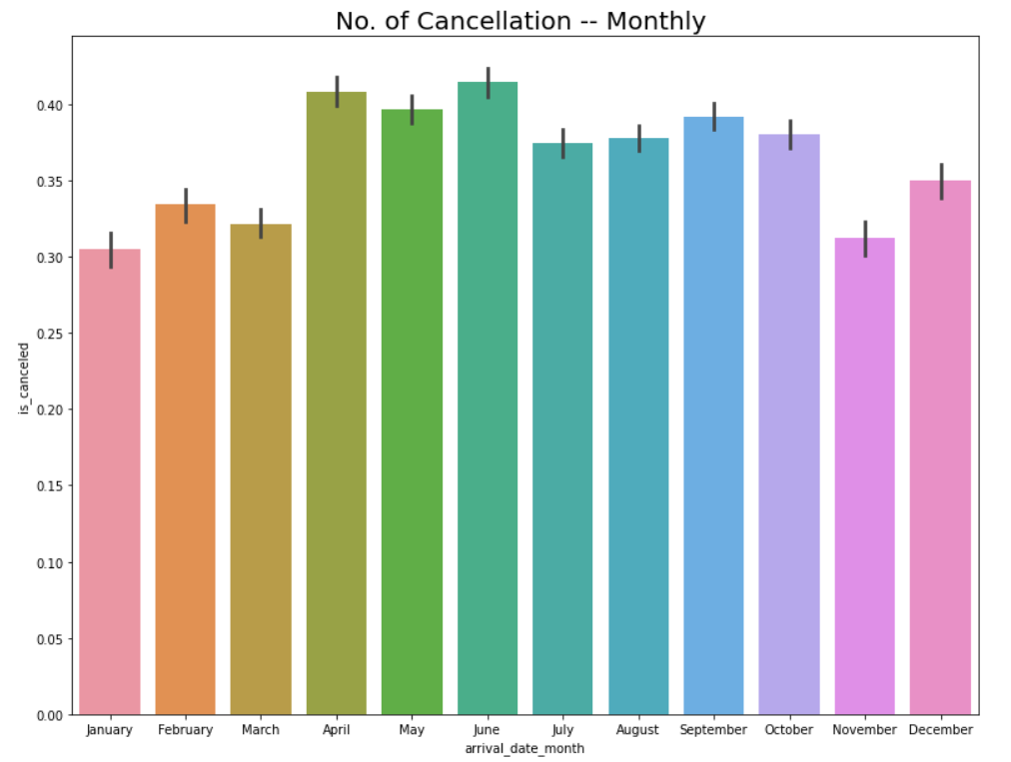
Month wise percentage of cancellations
Number of Cancellations are highest in June.

Slide 12
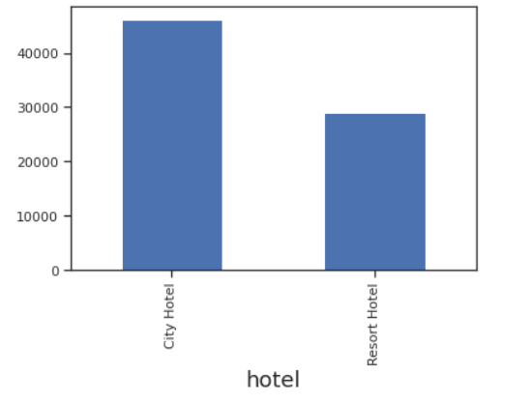
3. How many bookings were cancelled?
City Hotels has higher number of Cancellations.

Slide 13
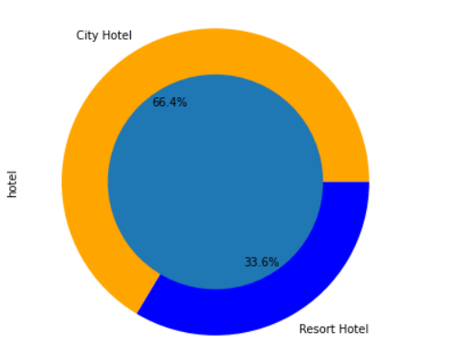
4. Booking percentage between 2 hotels
City Hotel has more booking percentage than Resort Hotel.
City Hotel – 66.4%
Resort Hotel – 33.6%

Slide 14
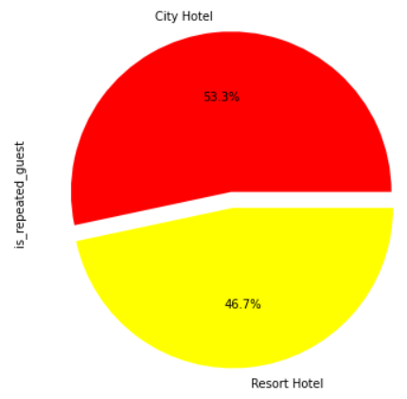
5. Repeated guests percentage between 2 hotels
City Hotel has more repeated guests with 53.3%.

Slide 15
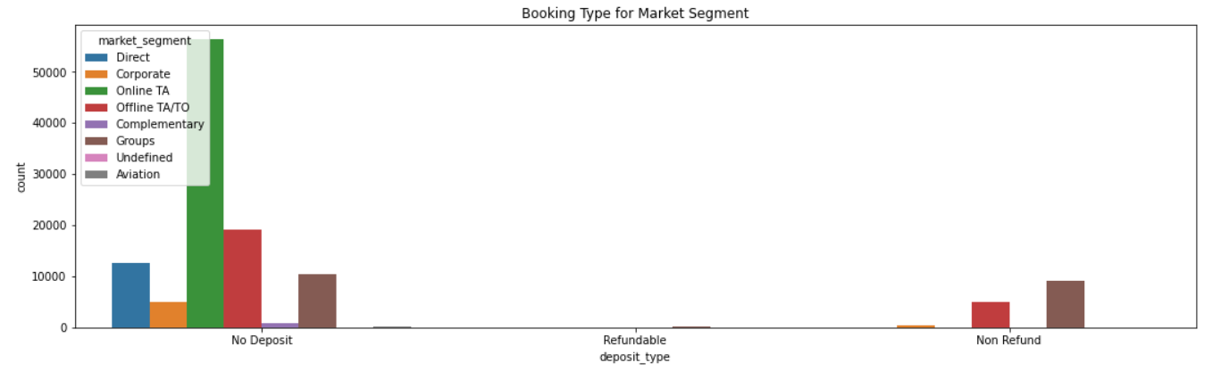
Booking types for Market segment
Online Bookings are the most Preferred among other Booking types.

Slide 16
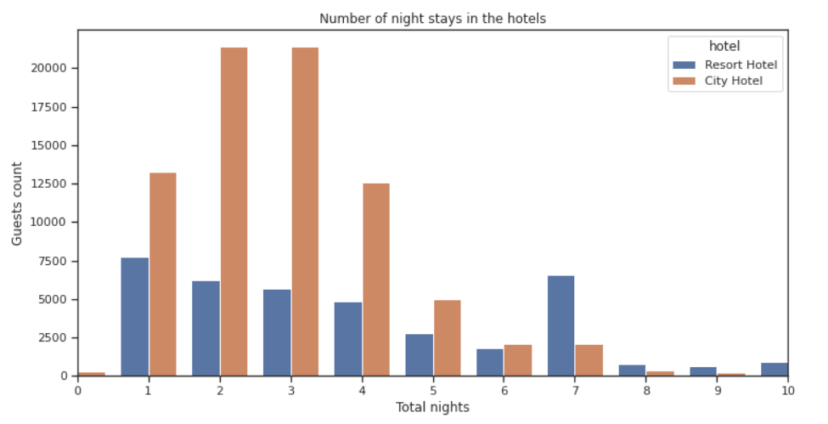
Number of night stays in Hotels
For short stay (1-5 Days), People prefer City Hotel.
For long stay (more than 6 Days), People prefer Resort Hotel.

Slide 17
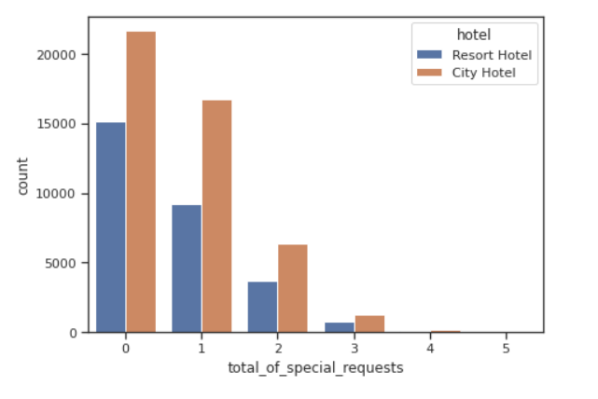
Total number of special requests
City Hotel has more Special requests than Resort Hotels.

Slide 18
Challenges
Data Cleaning
Database consists of many null values in it. So, converted null values to Zero.
Needed to convert some of float data types into int data type
Time taken to identify Problem statements

Slide 19
Conclusion
2016 has more number of Bookings with 47.5% and it went down to 34.1% in 2017.
Q2 & Q3 are having higher number of Bookings.
City Hotel has higher number of Bookings and Cancellations as well.
Repeated guests percentage is more for City Hotel.
Online Booking plays crucial role in Hotel Booking.
For Short stay people choose City Hotel.
For long stay people choose Resort Hotel.
Number of special requests for City Hotel is higher than Resort Hotel.

Slide 20
Suggestions
Hotels can avail some discount offers in Q1 and Q4 as Bookings rate is less in these quarters.
Hotels can promote their business online as most of the Bookings are coming from online portals.
Special discount can be given to repeated guests.
City Hotel can come up with special plans for long staying guests.
Resort Hotel can come up with special plans for short staying guests.

Slide 21
Thank You

